Slide 1

Our Corporate
Interior Design Services
INTERIOR & LANDSCAPE DESIGN CO.
Email; ladrilloltd@gmail.com
Tel: +250 788 506 118/ +250 788 340 667

Slide 2
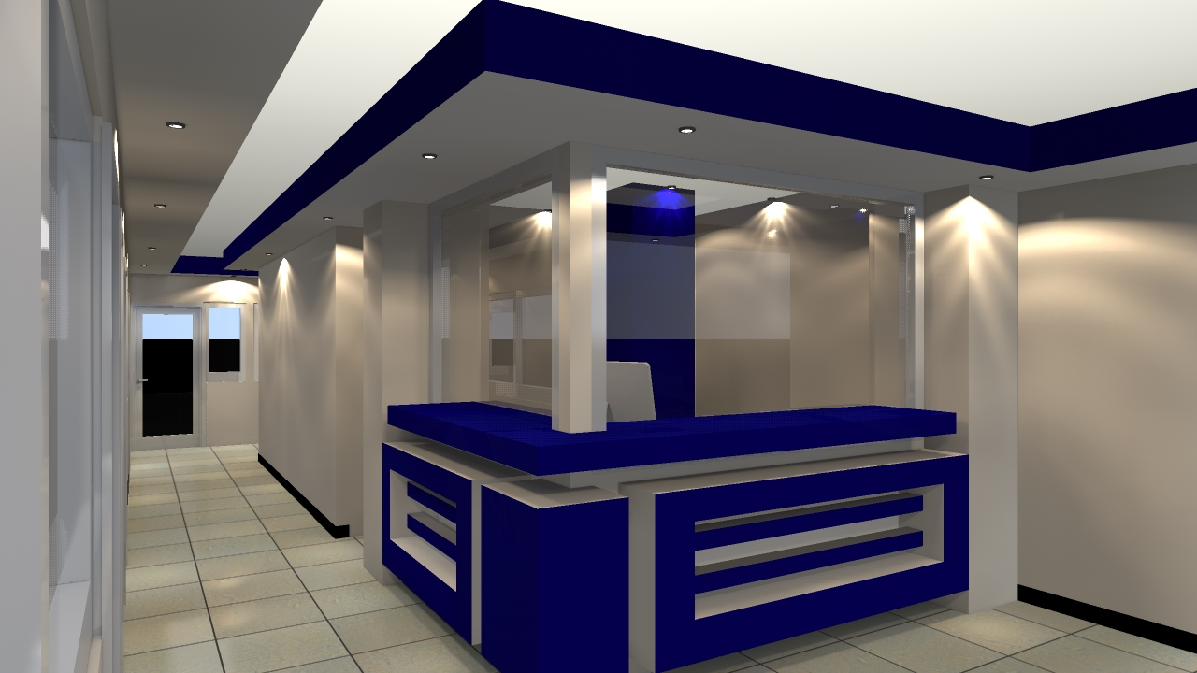

INTRODUCTION
With our unique professional touch, we transform your work stations and offices into a statement of your values. Our corporate portfolio covers a spectrum of office interior and exterior design products and services. In all product categories that follow we do the construction, installation, repair, and maintenance.
LADRILLO Ltd. is a Rwandan registered Interior and Exterior design company with office located in Kicukiro –S0natubes. The proprietors have over ten years leadership experience in furniture, fixtures, and fittings. This product offering evolves from the experience and concerted follow-up of market needs and trends.
Tel: +250 788 506 118/ +250 788 340 667
Email;ladrilloltd@gmail.com

Slide 3
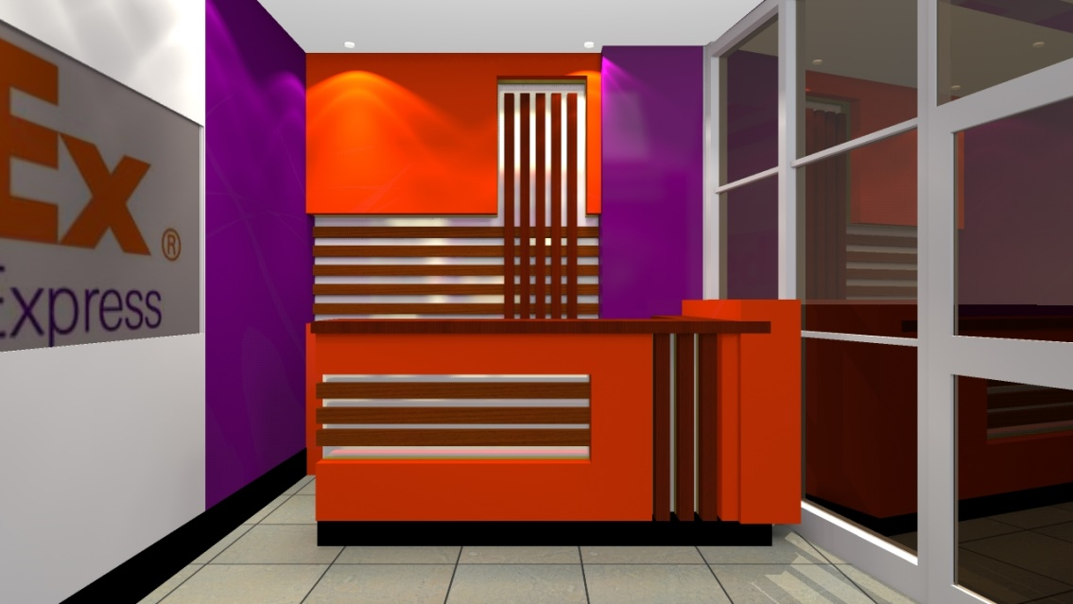
1. PARTITIONING
We design office spaces. Our partitioning portfolio includes all space-structuring concepts including screens and wall cladding. We design and construct vertical surfaces dividing the office floor in closed and open areas to provide acoustic and visual screening, or promote openness and transparency. We provide screen partitioning enabling privacy and concentration while sitting or wall cladding, which may expands the workplace, shapes and design walls.
We partition using various materials including gypsum, hard wood, MDF boards, soft wood, Glass, Aluminium, metal frames, concrete, and sometimes a combination of various materials.
1.OFFICE INTERIOR DESIGNING WITH OUTSTANDING SEATING ARRANGEMENT
Tel: +250 788 506 118/ +250 788 340 667
Email;ladrilloltd@gmail.com

Slide 4
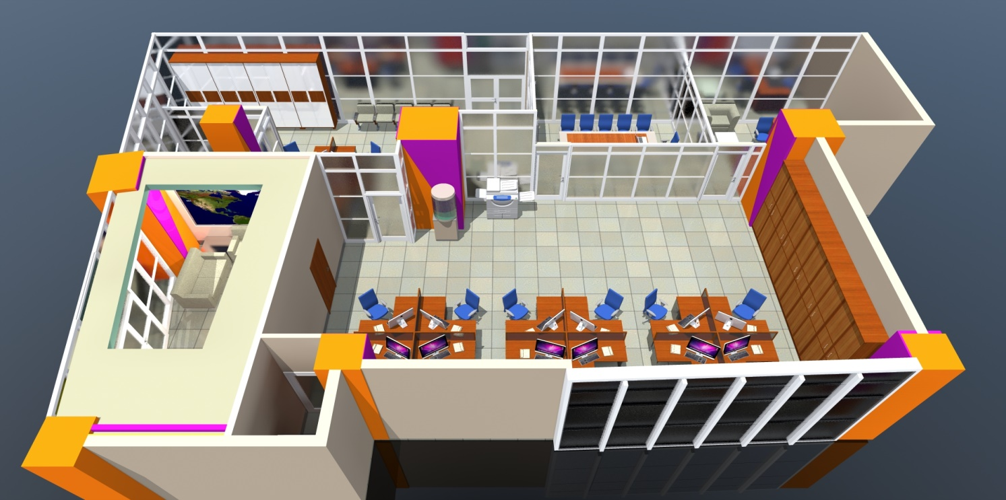
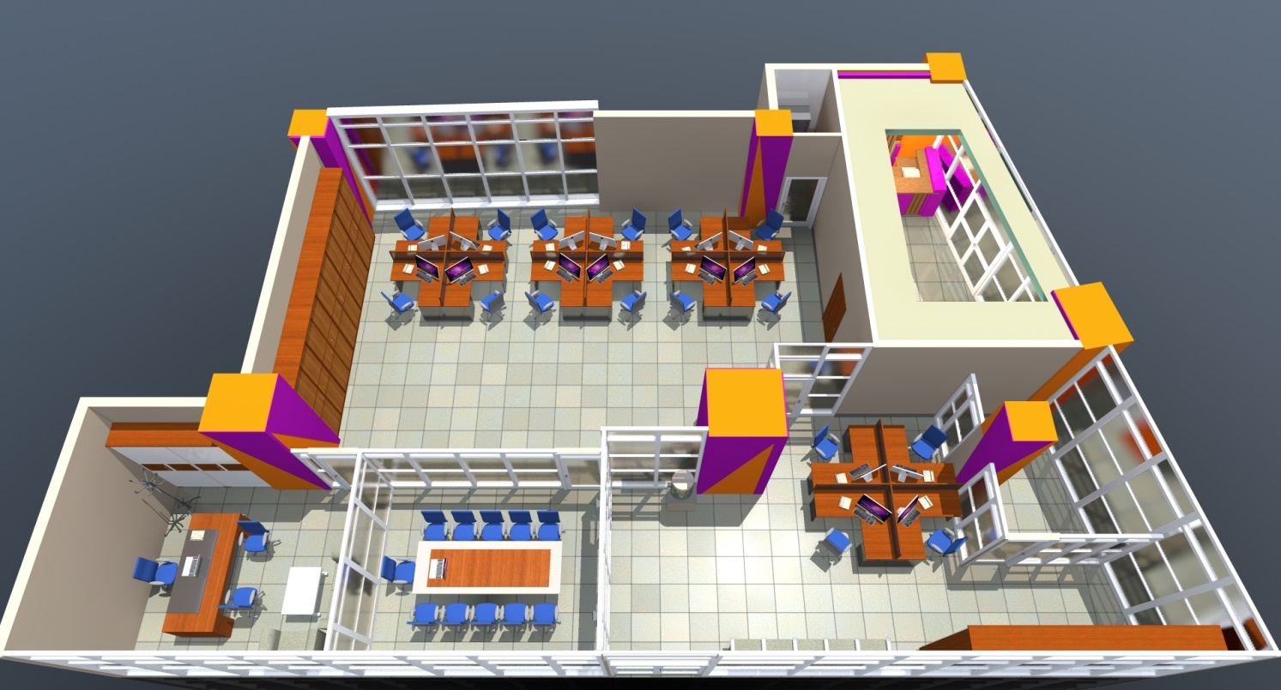
1. OFFICE PARTITIONING
Tel: +250 788 506 118/ +250 788 340 667
Email;ladrilloltd@gmail.com

Slide 5
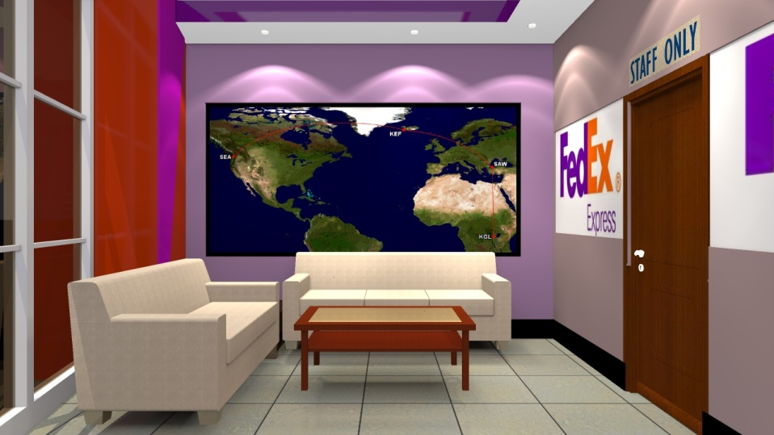
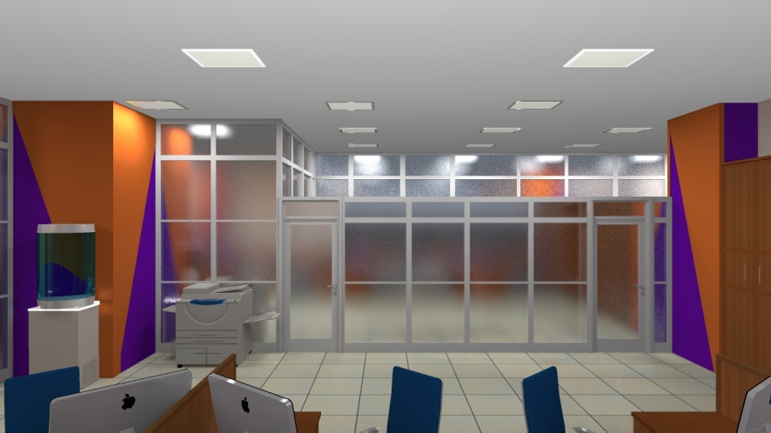
2.OFFICE FURNITURE
We construct various custom furniture products including work stations, storage cabinets, and chairs. The site and purpose of the furniture are the important ingredients that determine the our design proposition.
To us a promise is a promise. And we always deliver on time. Besides the construction, we repair office furniture. Additionally, we offer services of maintenance services under framework contracts.
Local fabrication of office waiting table.
Office interior Partitions and institutional color branding with seating arrangement suitable for users
Tel: +250 788 506 118/ +250 788 340 667
Email;ladrilloltd@gmail.com

Slide 6
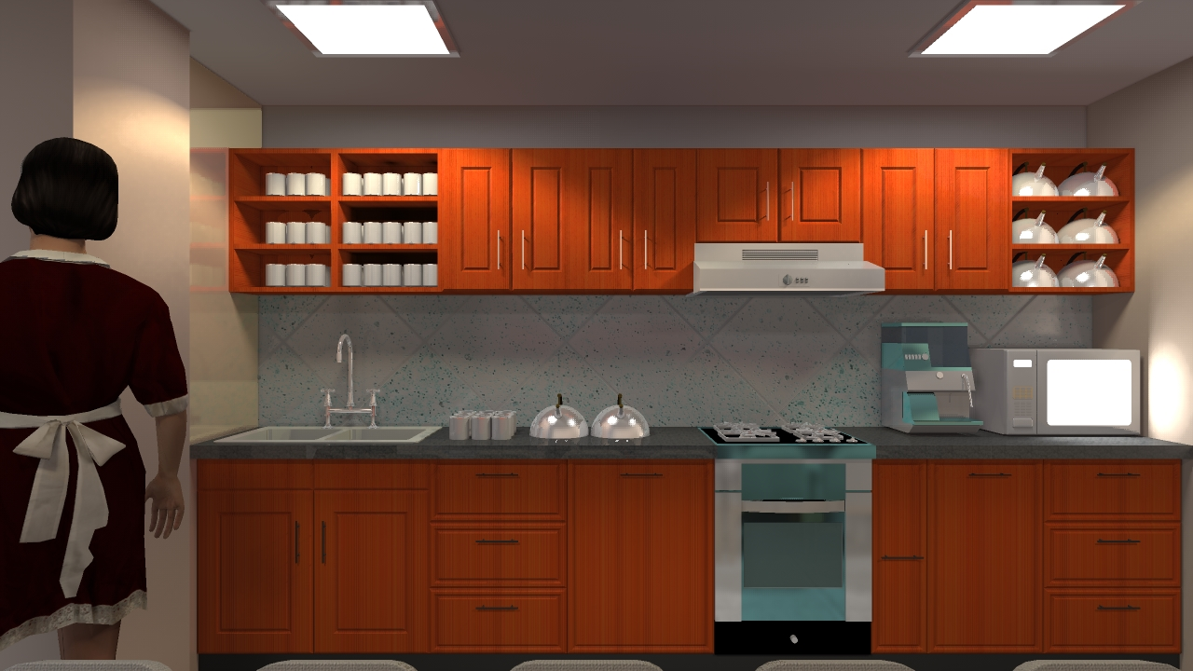
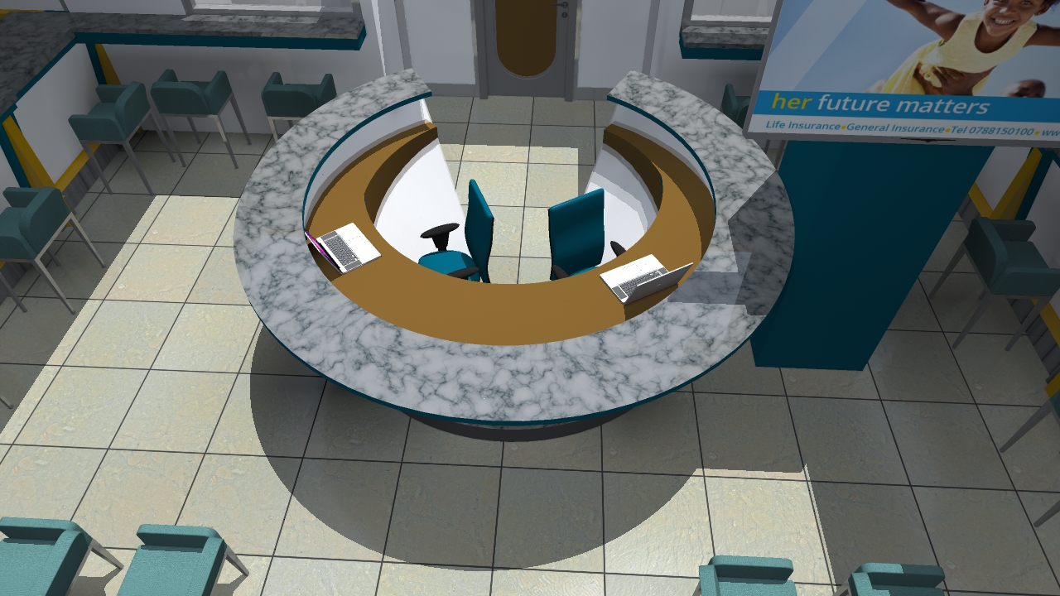
Oval office reception Design at PHOENIX Assurance at Grand Pension Plaza Building.

Slide 7
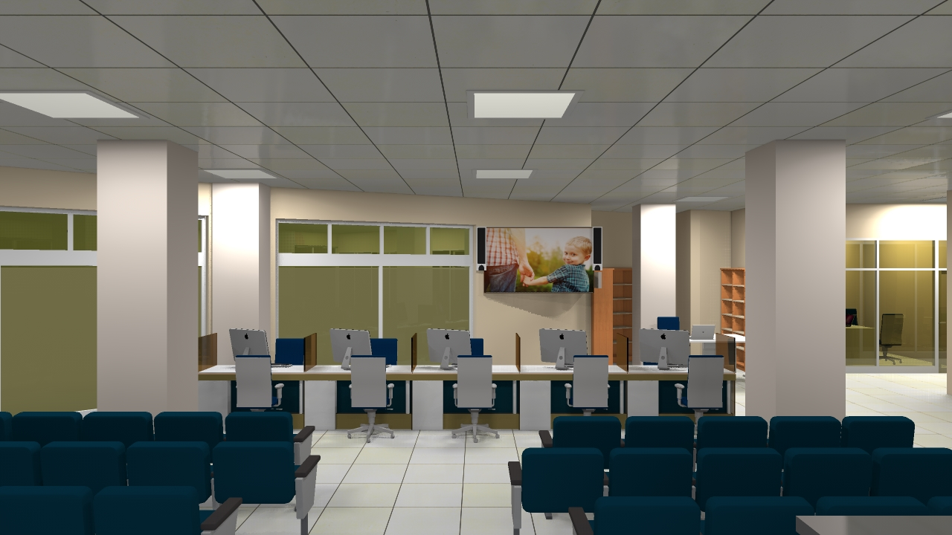
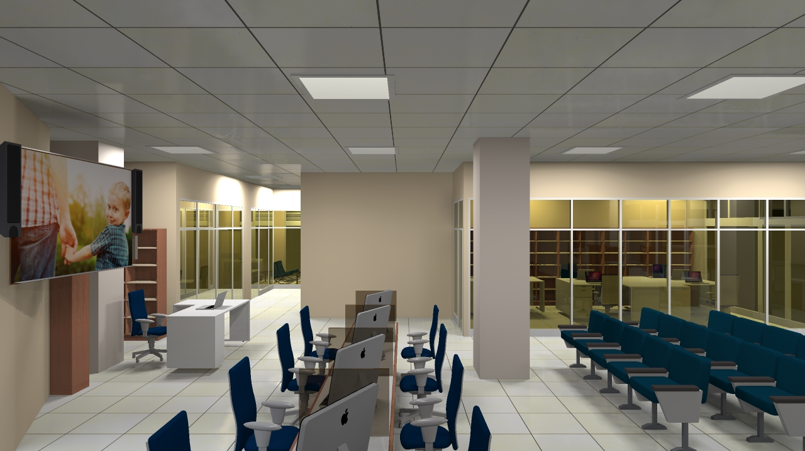
Underwriting tables Designed at PHOENIX Assurance at Grand Pension Plaza Building.
Tel: +250 788 506 118/ +250 788 340 667
Email;ladrilloltd@gmail.com

Slide 8
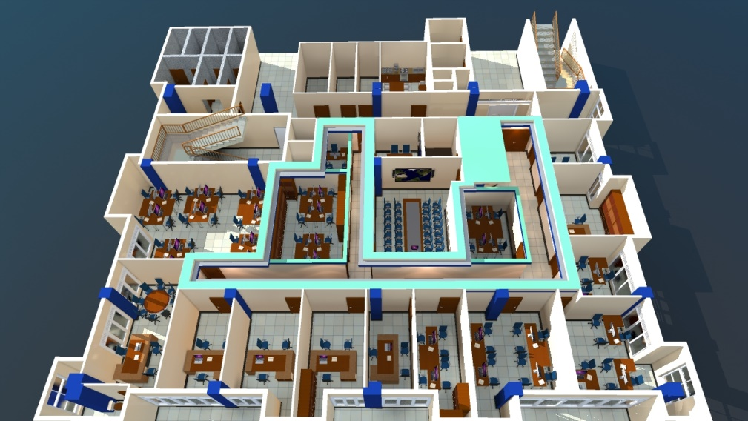
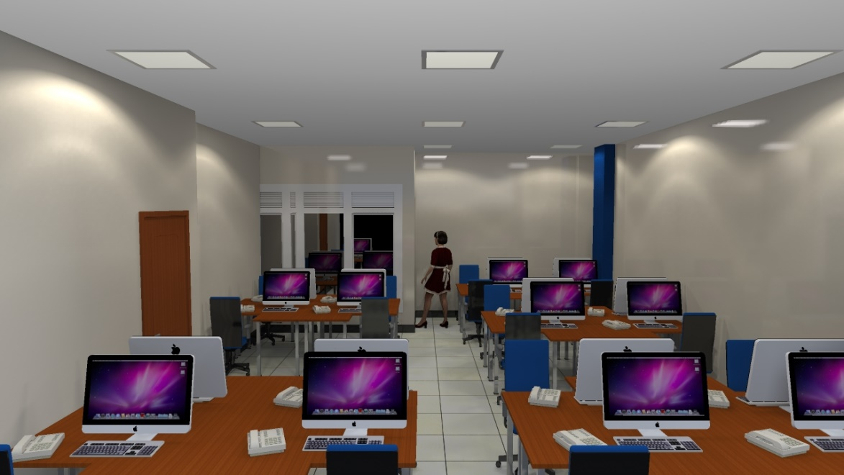
3.OFFICE DESIGN
Working area is the most important place require to be carefully planned because it has great effect in production of any organization. We provide special service in planning comfortable environment for our clients .
Office Design of Plan International@ GOLDEN PLAZA Building
Outstanding Space planning for Shared office @ at Plan International.
Tel: +250 788 506 118/ +250 788 340 667
Email;ladrilloltd@gmail.com

Slide 9
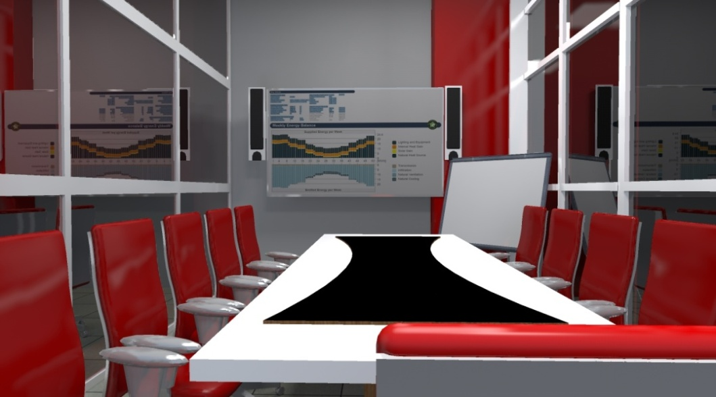
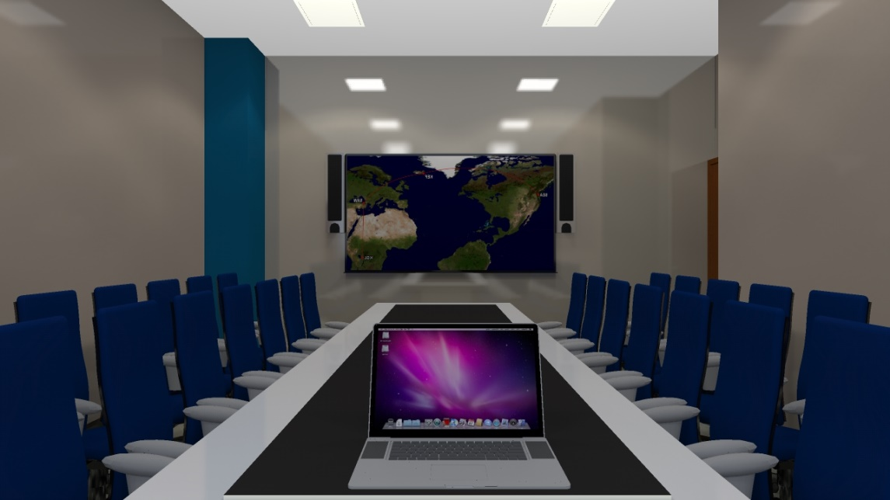
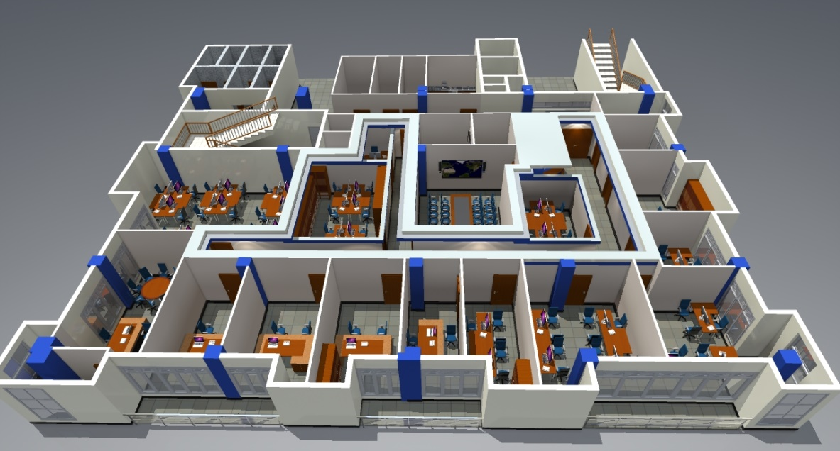
Office Design of Ethiopian AirLines @ M PEACE PLAZZA Building
CONFERENCE ROOM DESIGNED FOR EXECUTIVE MEETING@ Plan International.
Concept development of complex offices following rules and principles of design @ Golden plaza
Tel: +250 788 506 118/ +250 788 340 667
Email;ladrilloltd@gmail.com

Slide 10
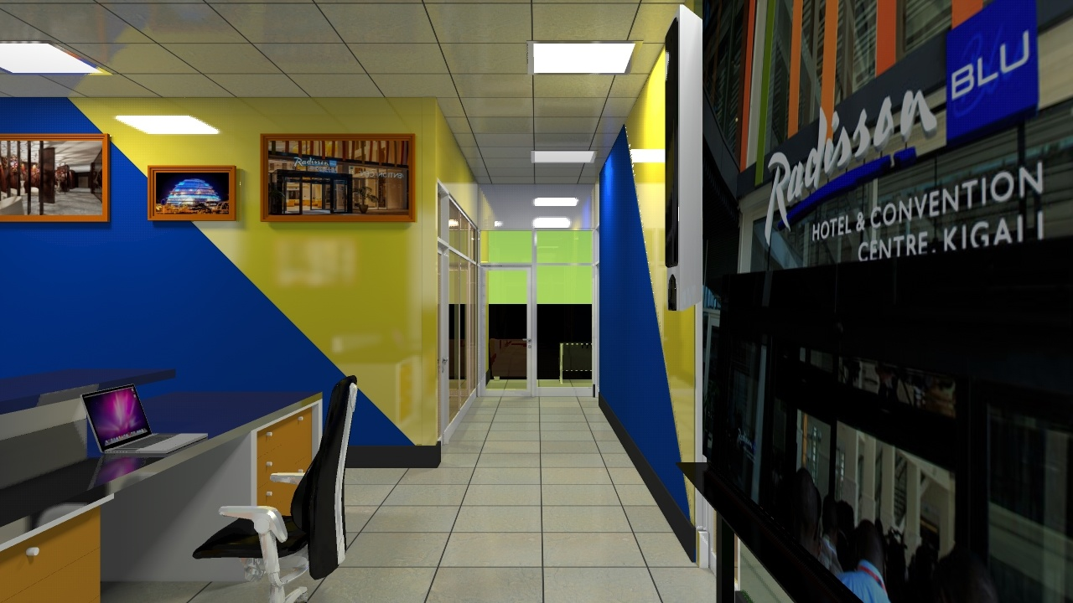
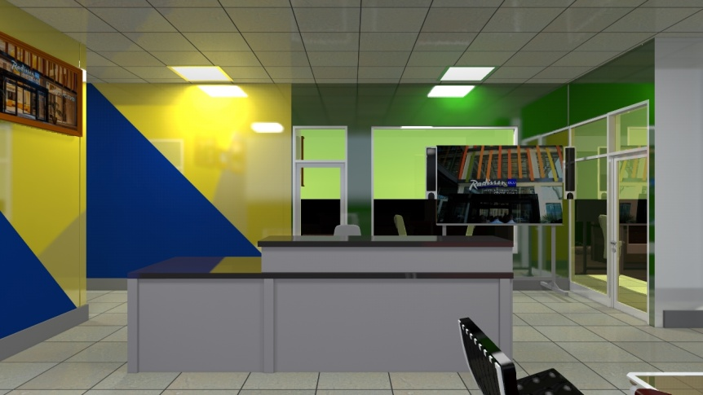
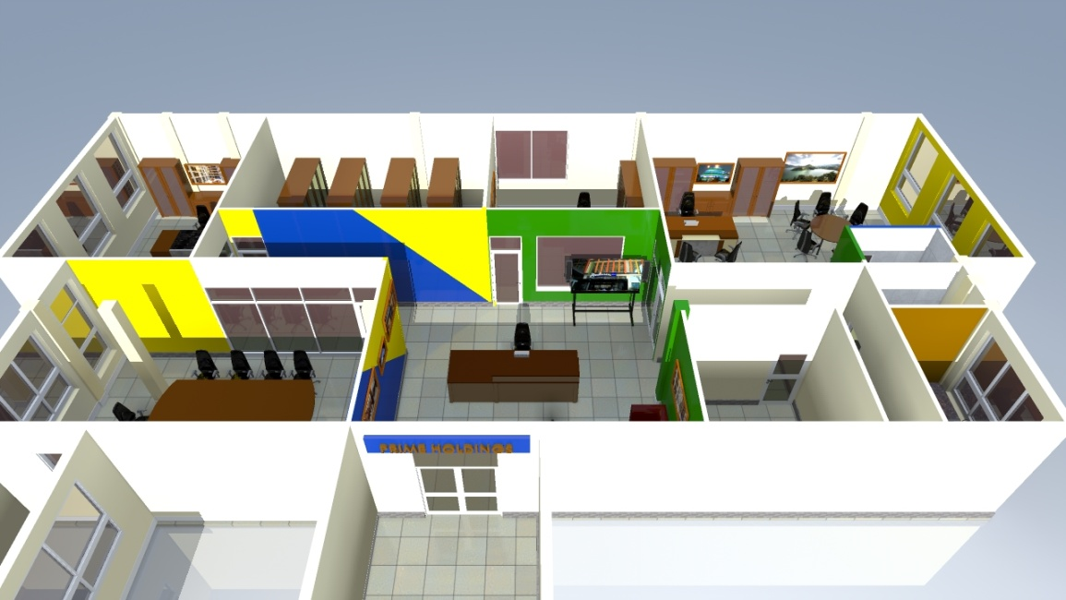
Office Design of PRIME HOLDINGS @ Kimihurura
Office Design of PRIME HOLDINGS @ Kimihurura
Tel: +250 788 506 118/ +250 788 340 667
Email;ladrilloltd@gmail.com

Slide 11
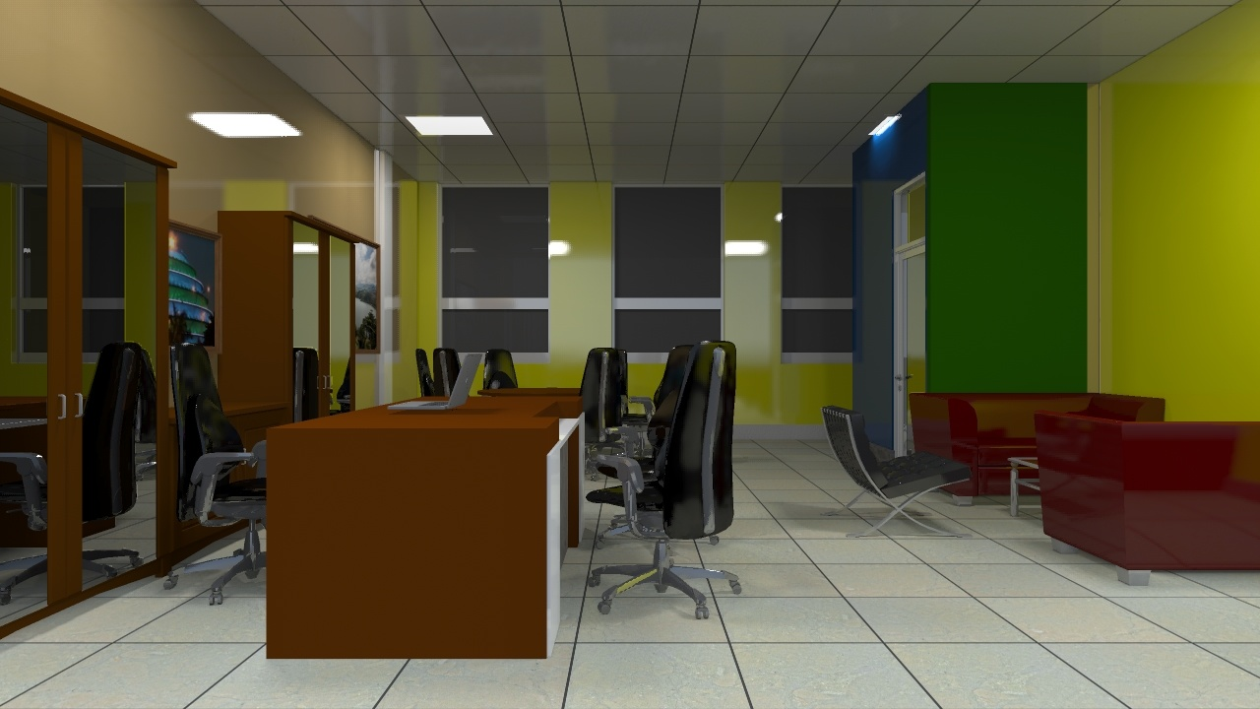
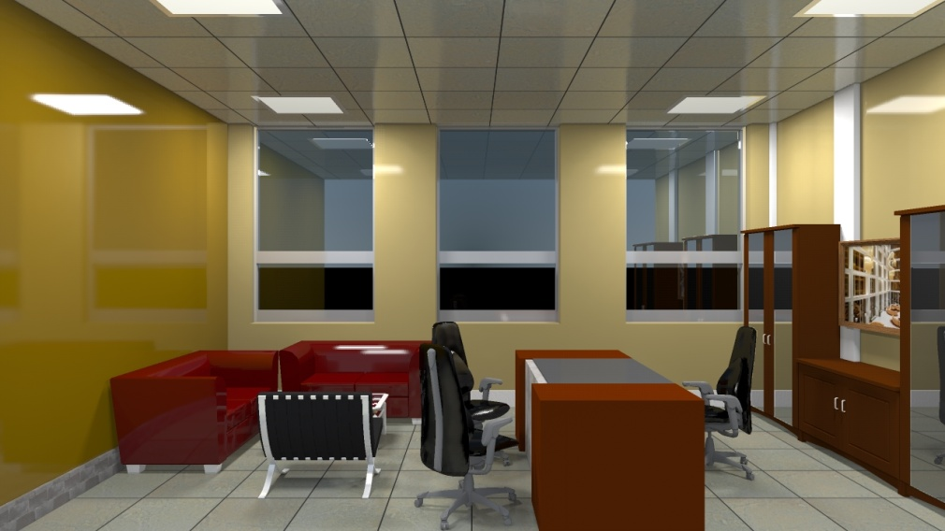
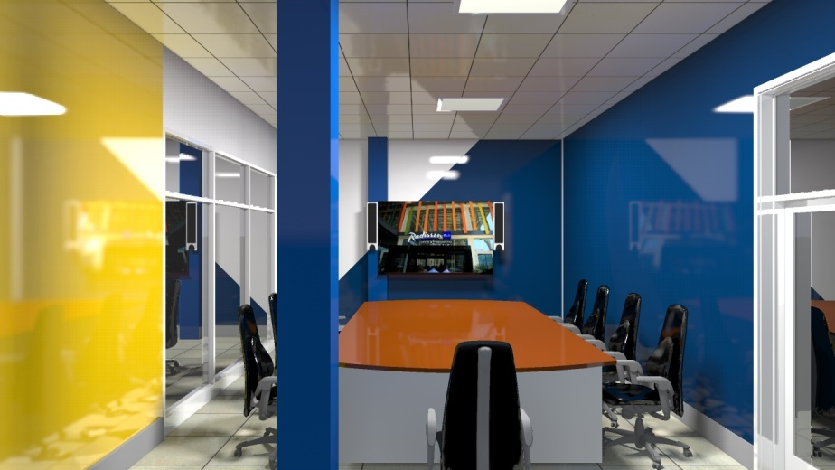
Office Design of PRIME HOLDINGS @ Kimihurura
Office Design of PRIME HOLDINGS @ Kimihurura
Tel: +250 788 506 118/ +250 788 340 667
Email;ladrillo@gmail.com

Slide 12
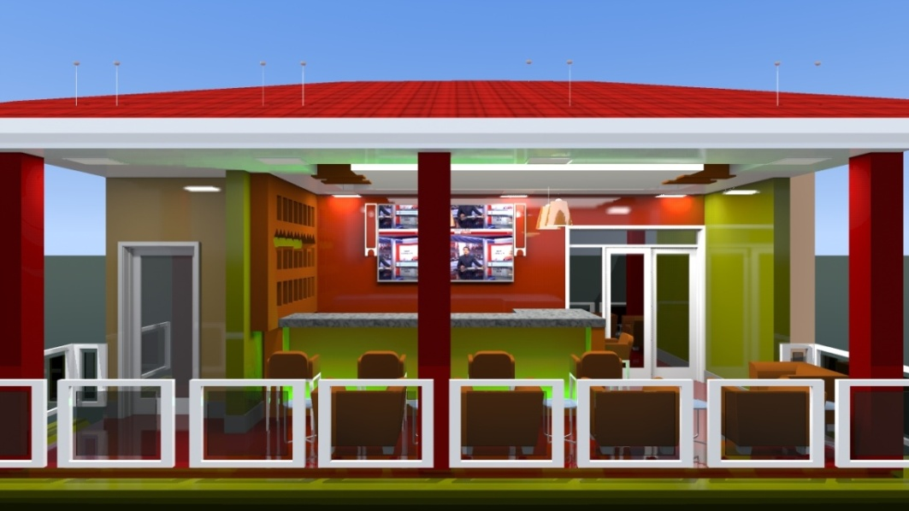
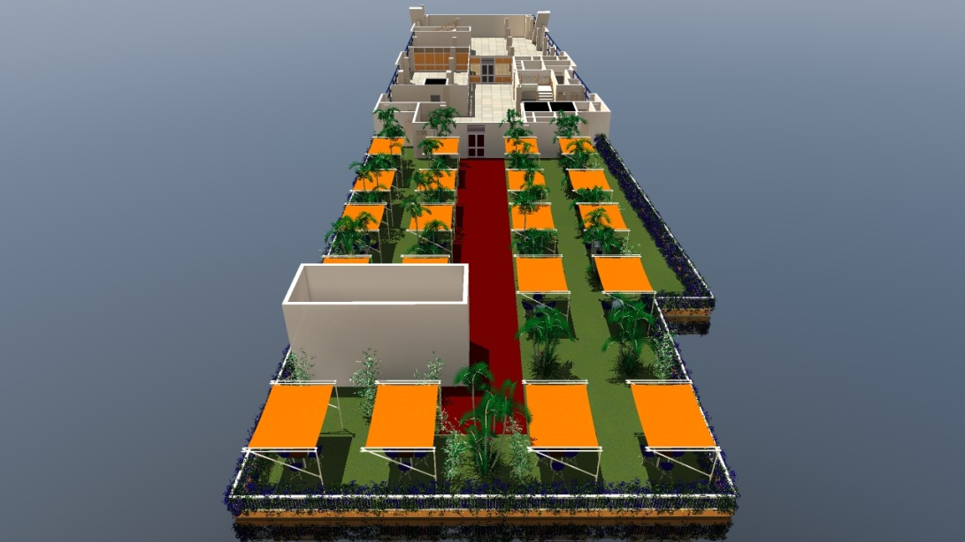
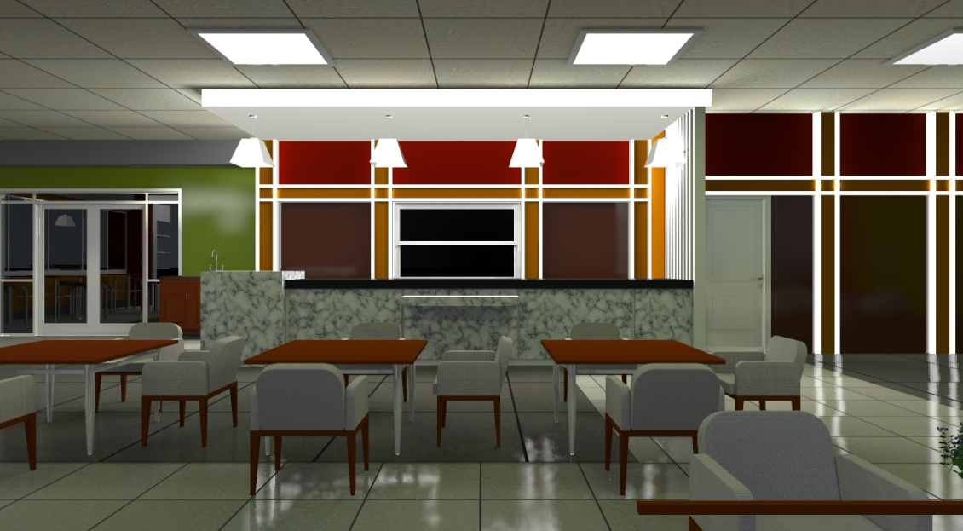
Home Bar interior Design @KIMIRONKO
Roof top Bar design at Kicukiro Center
Home Bar interior Design @NYARUGENGE
Tel: +250 788 506 118/ +250 788 340 667
Email;ladrilloltd@gmail.com

Slide 13
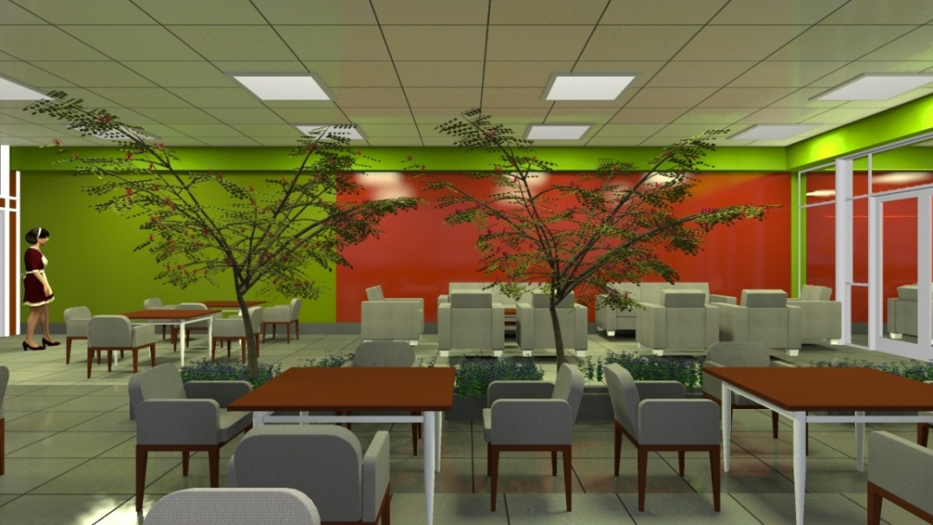
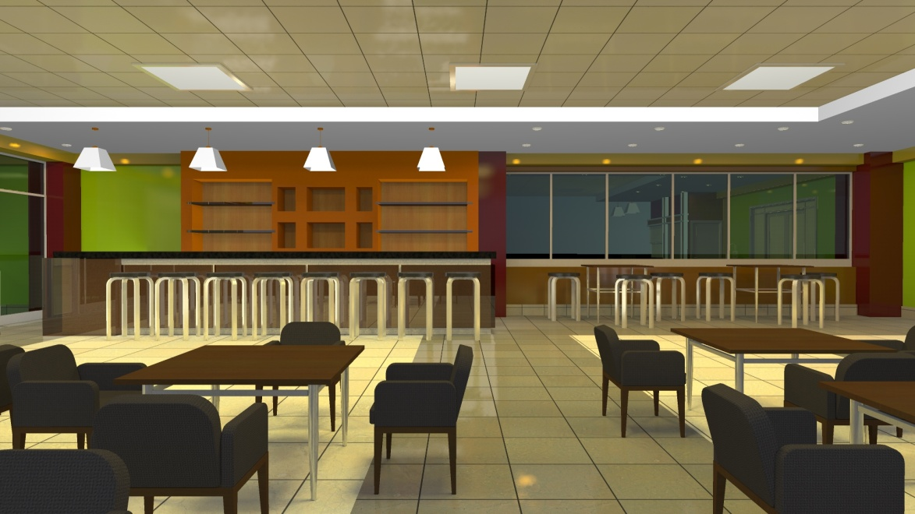
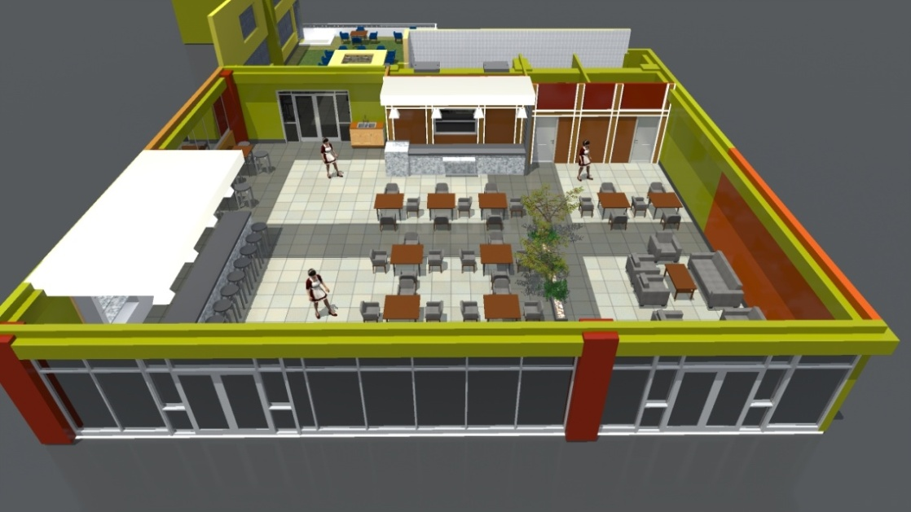
Bar interior Gardening Design Of STAC Bar and Resto @ MIC Building
Bar interior Design Of STAC Bar and Resto @ MIC Building
Bar interior Gardening Design Of STAC Bar and Resto @ MIC Building
Tel: +250 788 506 118/ +250 788 340 667
Email;ladrilloltd@gmail.com

Slide 14
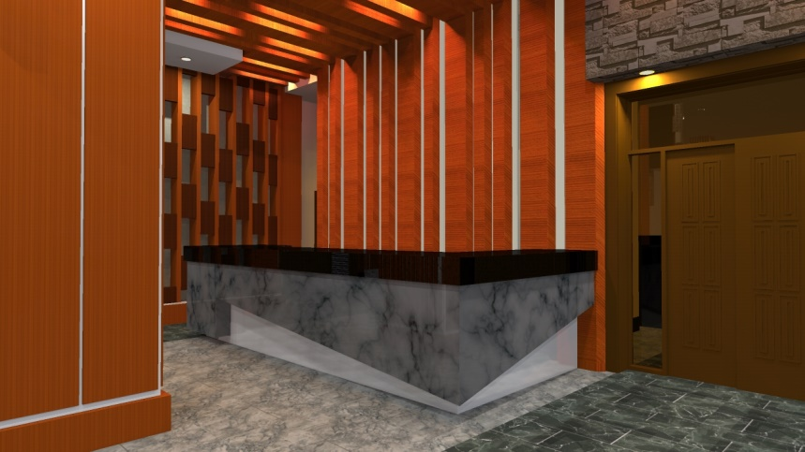
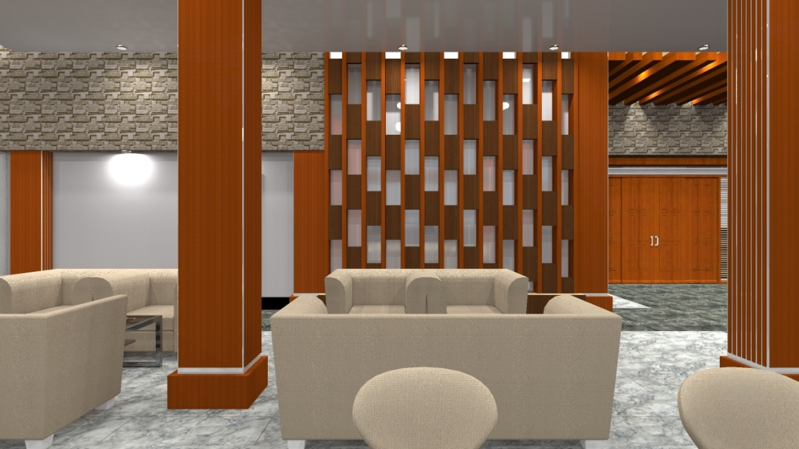
4. HOTELS AND APPARTMENTS INTERIOR DESIGN
We have an experience in consulting interior design project for hotels and apartments; making the standard Hotels design in Entrance reception , Robby , bar. And Apartment interior designing in Rooms, closet, kitchens and living room to fit different customs.
Pacific Hotel reception Design
Pacific Hotel Robby Design
Tel: +250 788 506 118/ +250 788 340 667
Email;ladrilloltd@gmail.com

Slide 15
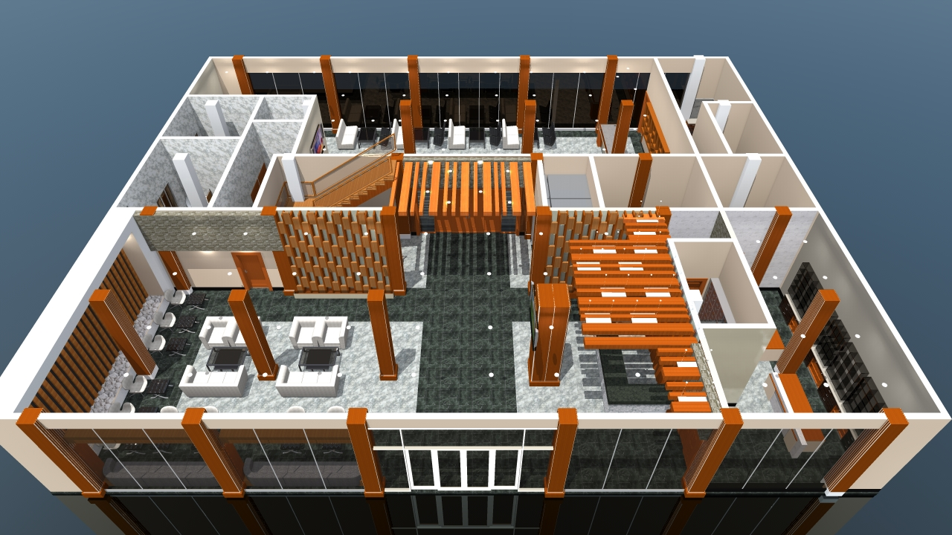
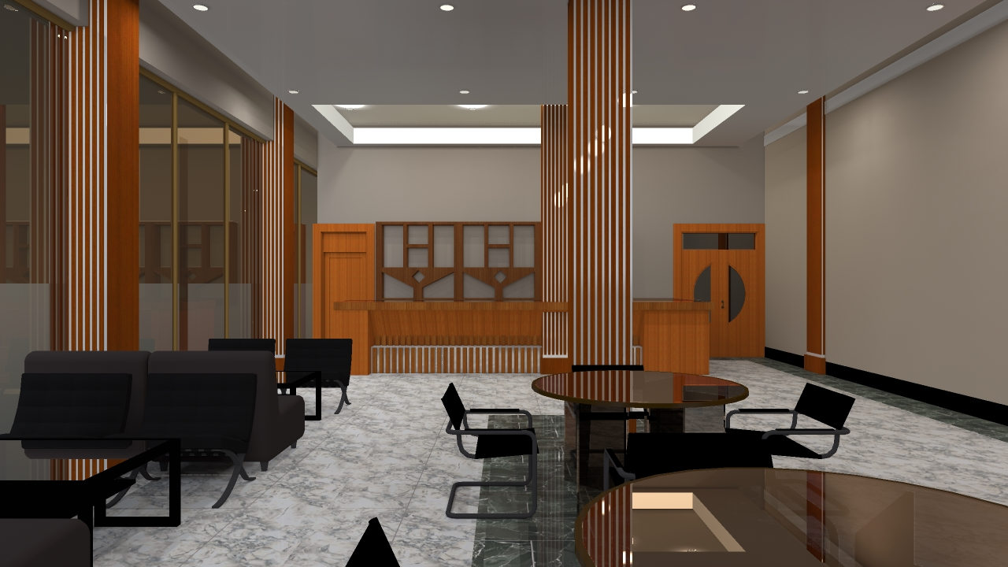
View of Expo stand Designs of RwandAir 2017
Aerial view of Hotel Robby and Reception at Pacific Hotel
Hotel bar designs and customers service area
Tel: +250 788 506 118/ +250 788 340 667
Email;ladrilloltd@gmail.com

Slide 16
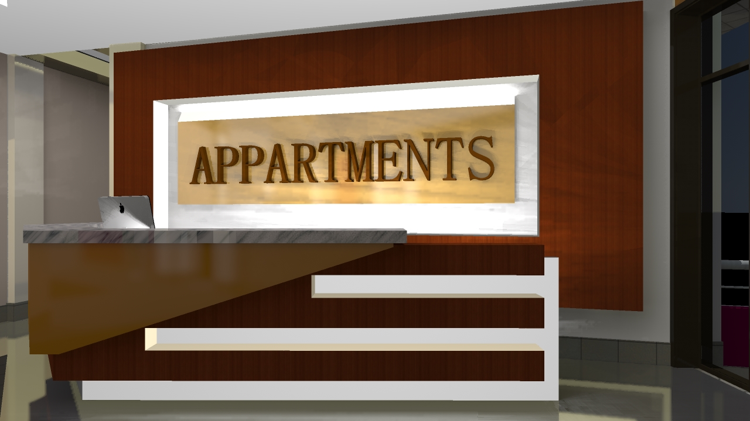
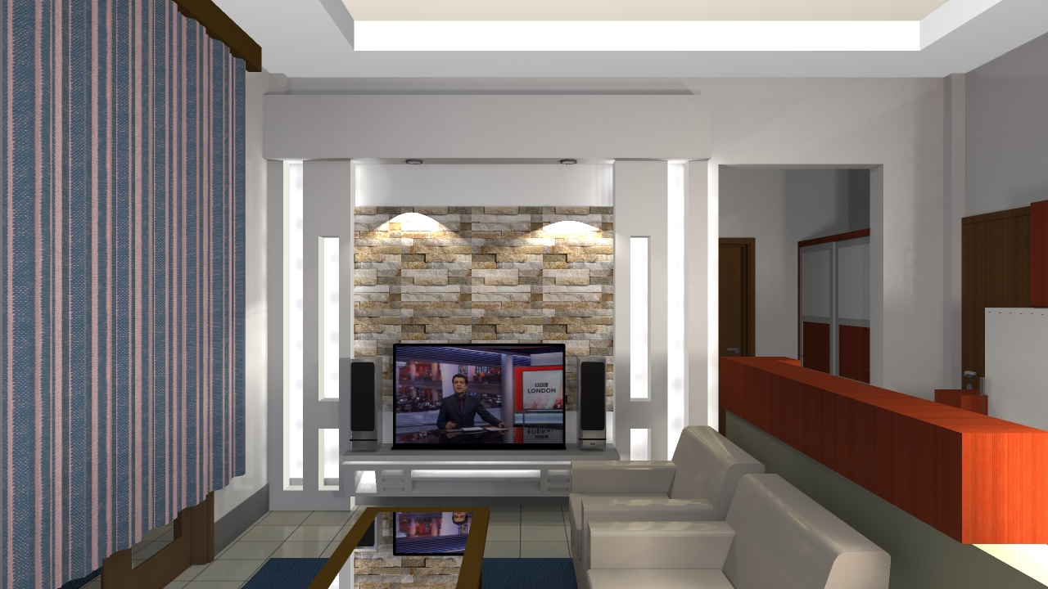
APPARTMENTS INTERIOR DESIGN
Apartment Reception interior Design
Apartment living room interior Design with outstanding TV stands
Tel: +250 788 506 118/ +250 788 340 667
Email;ladrilloltd@gmail.com

